Slide 1

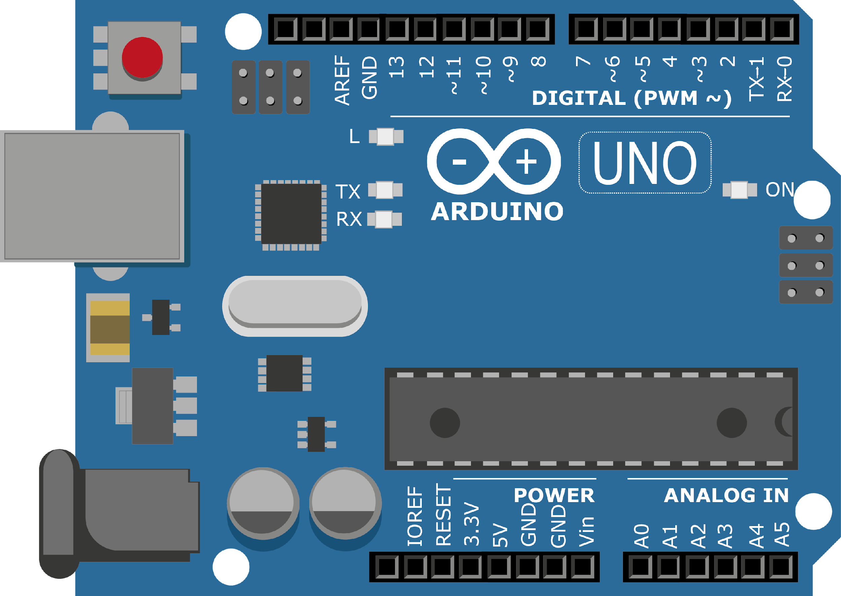
ARDUINO MASTER CLASS
05
Mobile Controlled Light | Bluetooth

Slide 2
5 AGENDA
02
03
01
UART Protocol
Serial Communication to control application
Bluetooth controlled applications

Slide 3
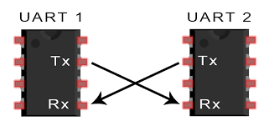
UART - Universal Asynchronous Receiver/Transmitter
A UART’s main purpose is to transmit
and receive serial data
In UART communication, two UARTs communicate directly with each other.
The transmitting UART converts parallel data from a controlling device like a
CPU into serial form, transmits it in serial to the receiving UART, which then
converts the serial data back into parallel data for the receiving device

Slide 4
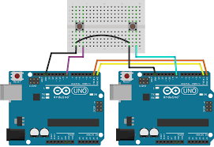
Communicating b/w 2 Microcontroller.

Slide 5
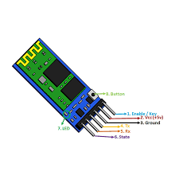
Bluetooth Module – HC-05
Serial Bluetooth module for Arduino and other microcontrollers
Operating Voltage: 4V to 6V (Typically +5V)
Operating Current: 30mA
Range: <100m
Works with Serial communication (USART) and TTL compatible
Follows IEEE 802.15.1 standardized protocol
Uses Frequency-Hopping Spread spectrum (FHSS)
Can operate in Master, Slave or Master/Slave mode
Can be easily interfaced with Laptop or Mobile phones with Bluetooth
Supported baud rate: 9600,19200,38400,57600,115200,230400,460800.

Slide 6
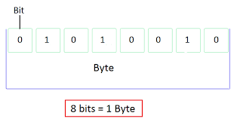
Read data as Byte
while(!Serial.available());
byte ByteRead = Serial.read();

Slide 7
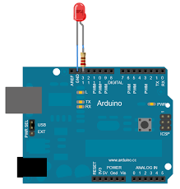
Controlling LED Via Serial Communication

Slide 8
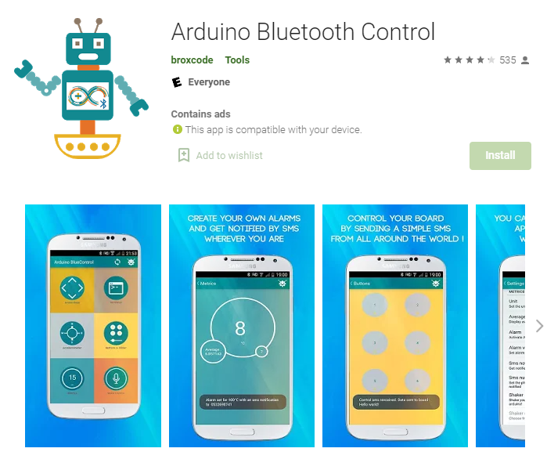
Android App - Arduino Bluetooth Control

Slide 9
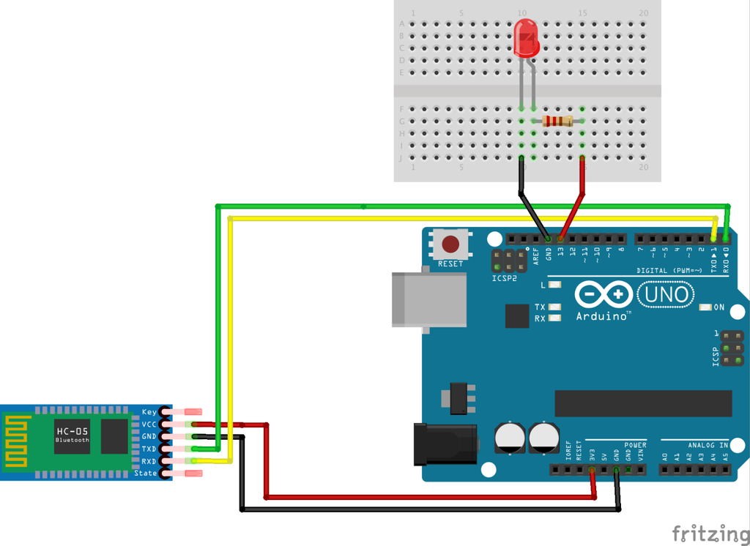
Connecting Bluetooth Module with LED

Slide 10
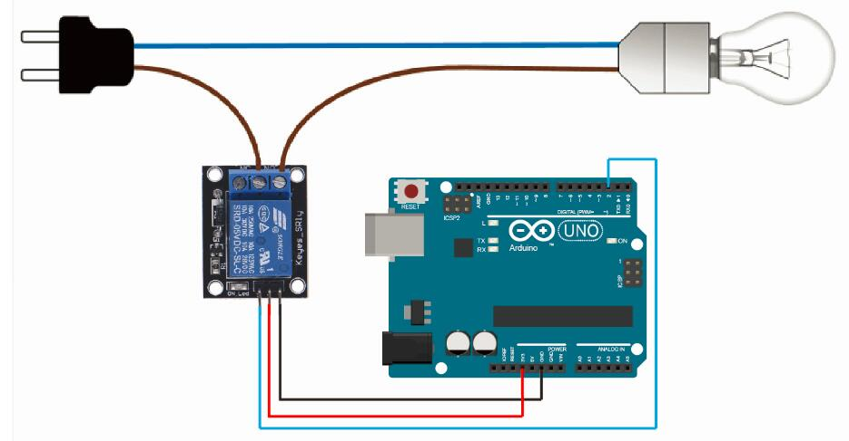
Connecting Real appliance with Arduino using Relay

Slide 11

INTERVIEW QUESTIONS
What is Handshaking?
Difference b/w UART & USART
What is Serial communication?
The method used by RS-232 for communication allows for a simple connection of three lines: TX, RX, and ground.
For the data to be transmitted, both sides have to be clocking the data at the same baud rate.
The serial port sends and receives bytes of information one bit at a time. This is slower than parallel communication, which allows the transmission of an entire byte at once; however, it is simpler and can be used over longer distances.

Slide 12
UART USART
Universal Asynchronous Receiver/Transmitter.
There is no incoming clock signal that is associated with the data, so the receiver needs to know baud-rate of the transmitter before the initiation of reception.
In which require only the data line.
Data is transmitted character or byte by byte.
It cannot be work like USART.
Universal Synchronous Asynchronous Receiver/Transmitter.
In which receiver does not need to know the baud-rate of the transmitter. It is derived from the clock signal and the data line provided by the master.
In which require both data and clock line.
The synchronous data is transmitted in the form of blocks.
USART can be worked like UART.

Slide 13

THANKS!

